Slide 1

BC2410, Prescriptive Analytics From Data to Decision
Hands-on with RSOME

Slide 2
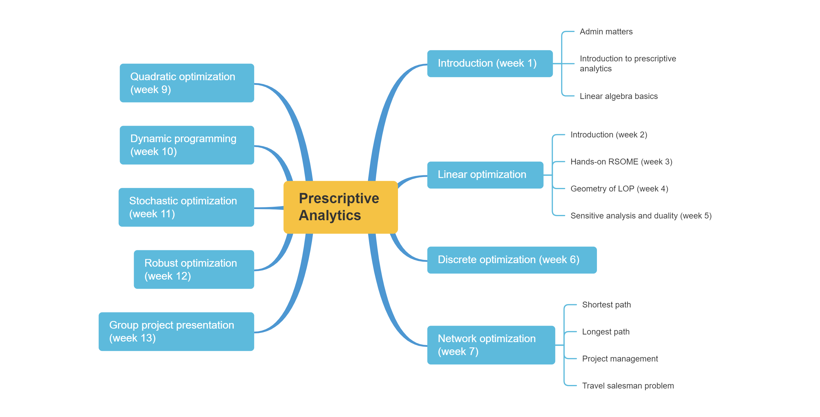
Schedule

Slide 3
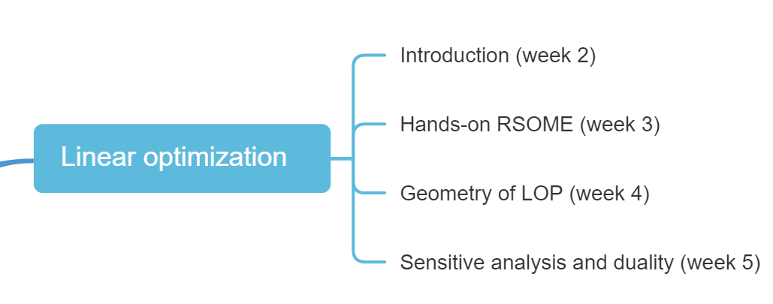
Schedule

Slide 4
RSOME Package in Python
RSOME
Developed by Peng Xiong, Zhi Chen for algebraic formulation of generic optimization problems including robust stochastic optimization models.
https://xiongpengnus.github.io/rsome/

Slide 5
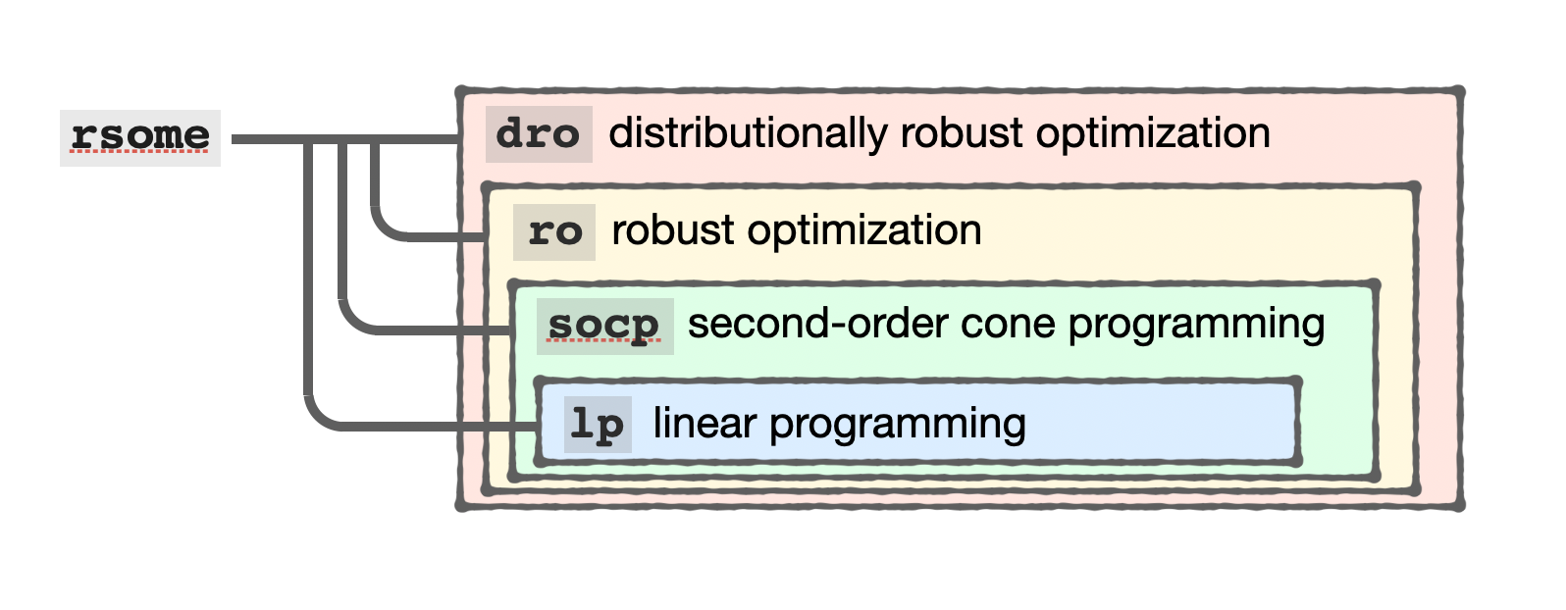
RSOME Environment
RSOME provides four layers of modelling environments:
from rsome import ro

Slide 6
RSOME Methods
Decision defined by dvar()
Objective function
x = model.dvar(3, vtype = ‘I’) # 3 integer variables as 1D array
y = model.dvar((3,5), ‘B’) # 3×5 binary variables as 2D array
z = model.dvar((2,3,4,5)) # 2×3×4×5 continuous variables as 4D array
model.min(b @ x) # minimize the objective function b @ x
model.max(b @ x) # maximize the objective function b @ x
Notes:
If you do not specify the type of the decision variable, by default, it is continuous.

Slide 7
RSOME Methods
Constraints are specified by the method st() or “subject to”.
model.st(A @ x <= c) # define one constraint
model.st(y.sum() >= 1,
y.sum(axis = 1) >= 0,
A * y + x >= 0) # define multiple constraints
model.st(x[i] <= i for i in range(3)) # define one constraint
Notes:
Try the last way of defining a constraint first.

Slide 8
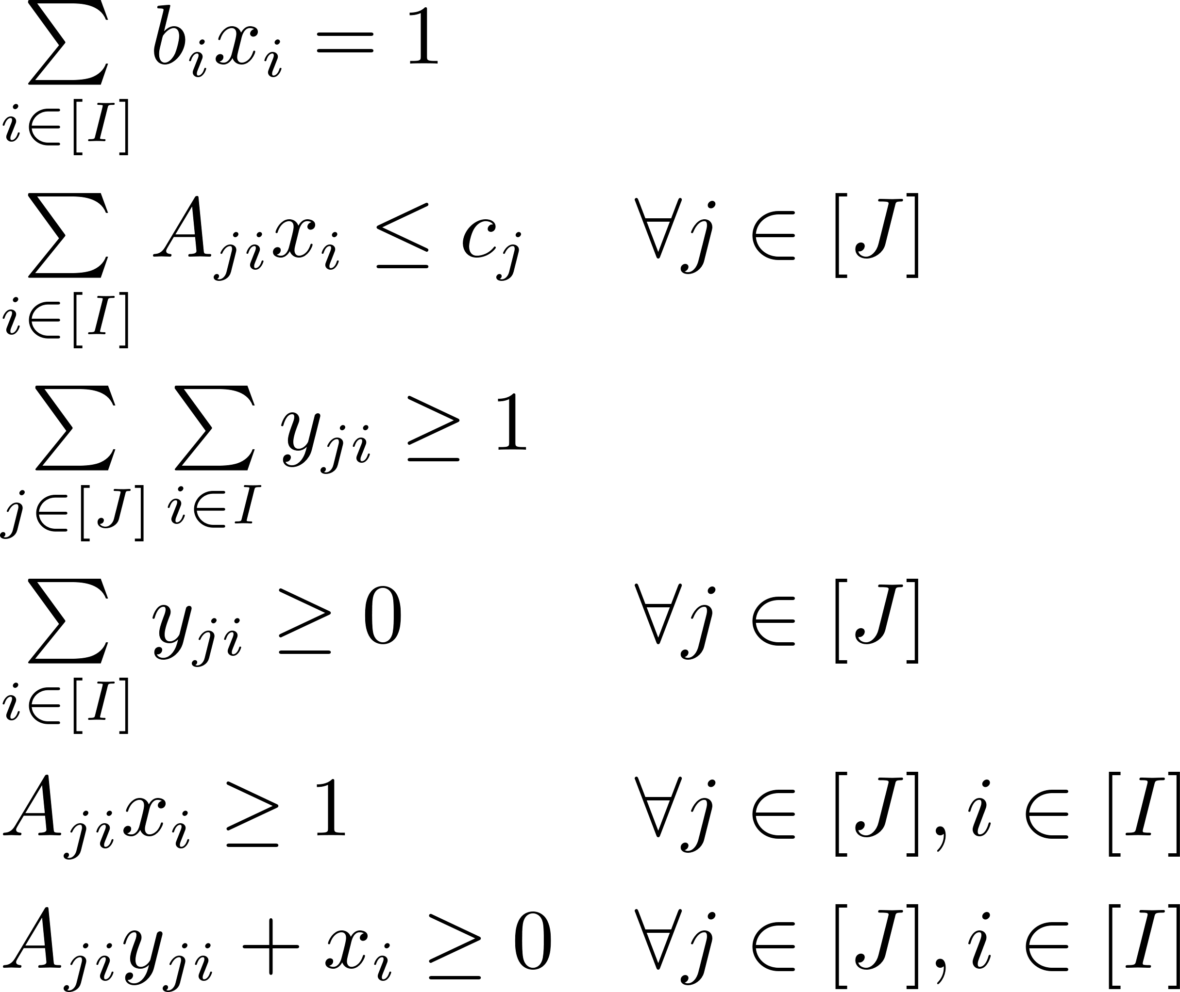
RSOME Methods
Follow closely with NumPy syntax
Constraints
x = model.dvar(I) # I variables
y = model.dvar((J,I)) # J×I variables
b @ x == 1
A @ x <= C
y.sum() >= 1
y.sum(axis = 1) >= 1
A * x >= 1
A * y + x >= 0
Notes:
@ and *, both should be fine

Slide 9
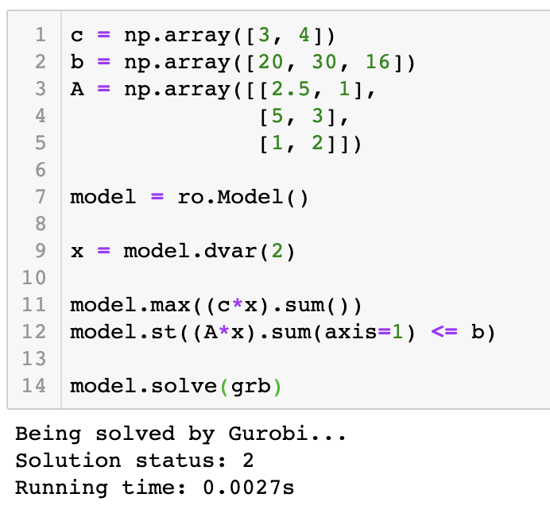

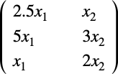
RSOME Methods
Broadcasting
@ and *

Slide 10
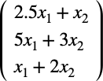
RSOME Methods
Broadcasting
Sum with axis=1
@ and *

Slide 11
RSOME Methods
from rsome import grb_solver as grb
model.solve(grb)
print(‘x:’, x.get())
Print(‘Obj:’, model.get())
Model is solved by method solve()
Solution(s)/objective value can be retrieved by the method dvar.get()

Slide 12


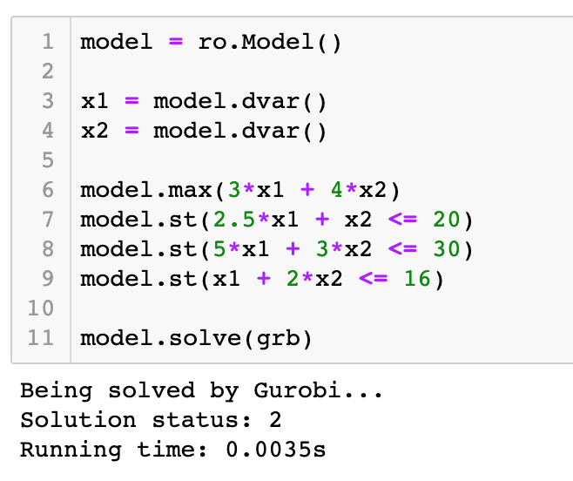
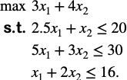
RSOME Examples
Define an optimization model
Example 1
Solve the linear programming problem:
Define decision variables
Solve model by Gurobi

Slide 13
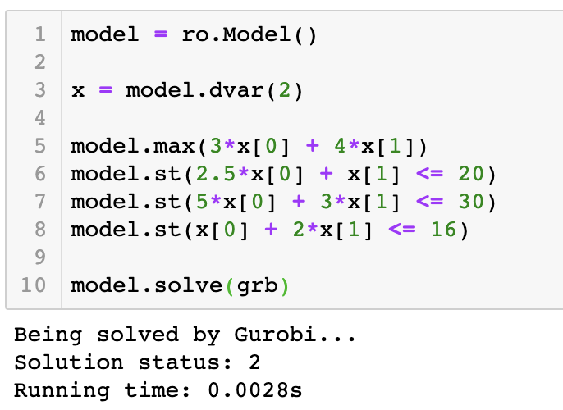
RSOME Examples
Define an optimization model
Example 1
Solve the linear programming problem:
Define decision variables as an array
Solve model by Gurobi

Slide 14

RSOME Examples - Transportation Problem
Example 2
A company has three PC assembly plants at locations 1, 2, and 3, with monthly production capacity of 1700 units, 2000 units, and 1700 units, respectively. Their PC's are sold through four retail outlets in locations A, B, C, and D, with monthly orders of 1700 units, 1000 units, 1500 units, and 1200 units respectively. The shipping costs from each plant to each outlet are presented in the following table. Use a linear programming model to find out the optimal shipping decision.
Shipping costs ($/unit) | A | B | C | D
1 | 5 | 3 | 2 | 6
2 | 7 | 7 | 8 | 10
3 | 6 | 5 | 3 | 8

Slide 15





RSOME Examples - Transportation Problem
Example 2
A company has three PC assembly plants at locations 1, 2, and 3, with monthly production capacity of 1700 units, 2000 units, and 1700 units, respectively. Their PC's are sold through four retail outlets in locations A, B, C, and D, with monthly orders of 1700 units, 1000 units, 1500 units, and 1200 units respectively. The shipping costs from each plant to each outlet are presented in the following table. Use a linear programming model to find out the optimal shipping decision.
Shipping costs ($/unit) | A | B | C | D
1 | 5 | 3 | 2 | 6
2 | 7 | 7 | 8 | 10
3 | 6 | 5 | 3 | 8
a
b
c
A
B
C
D

Slide 16
RSOME Examples - Transportation Problem
General representation

Slide 17
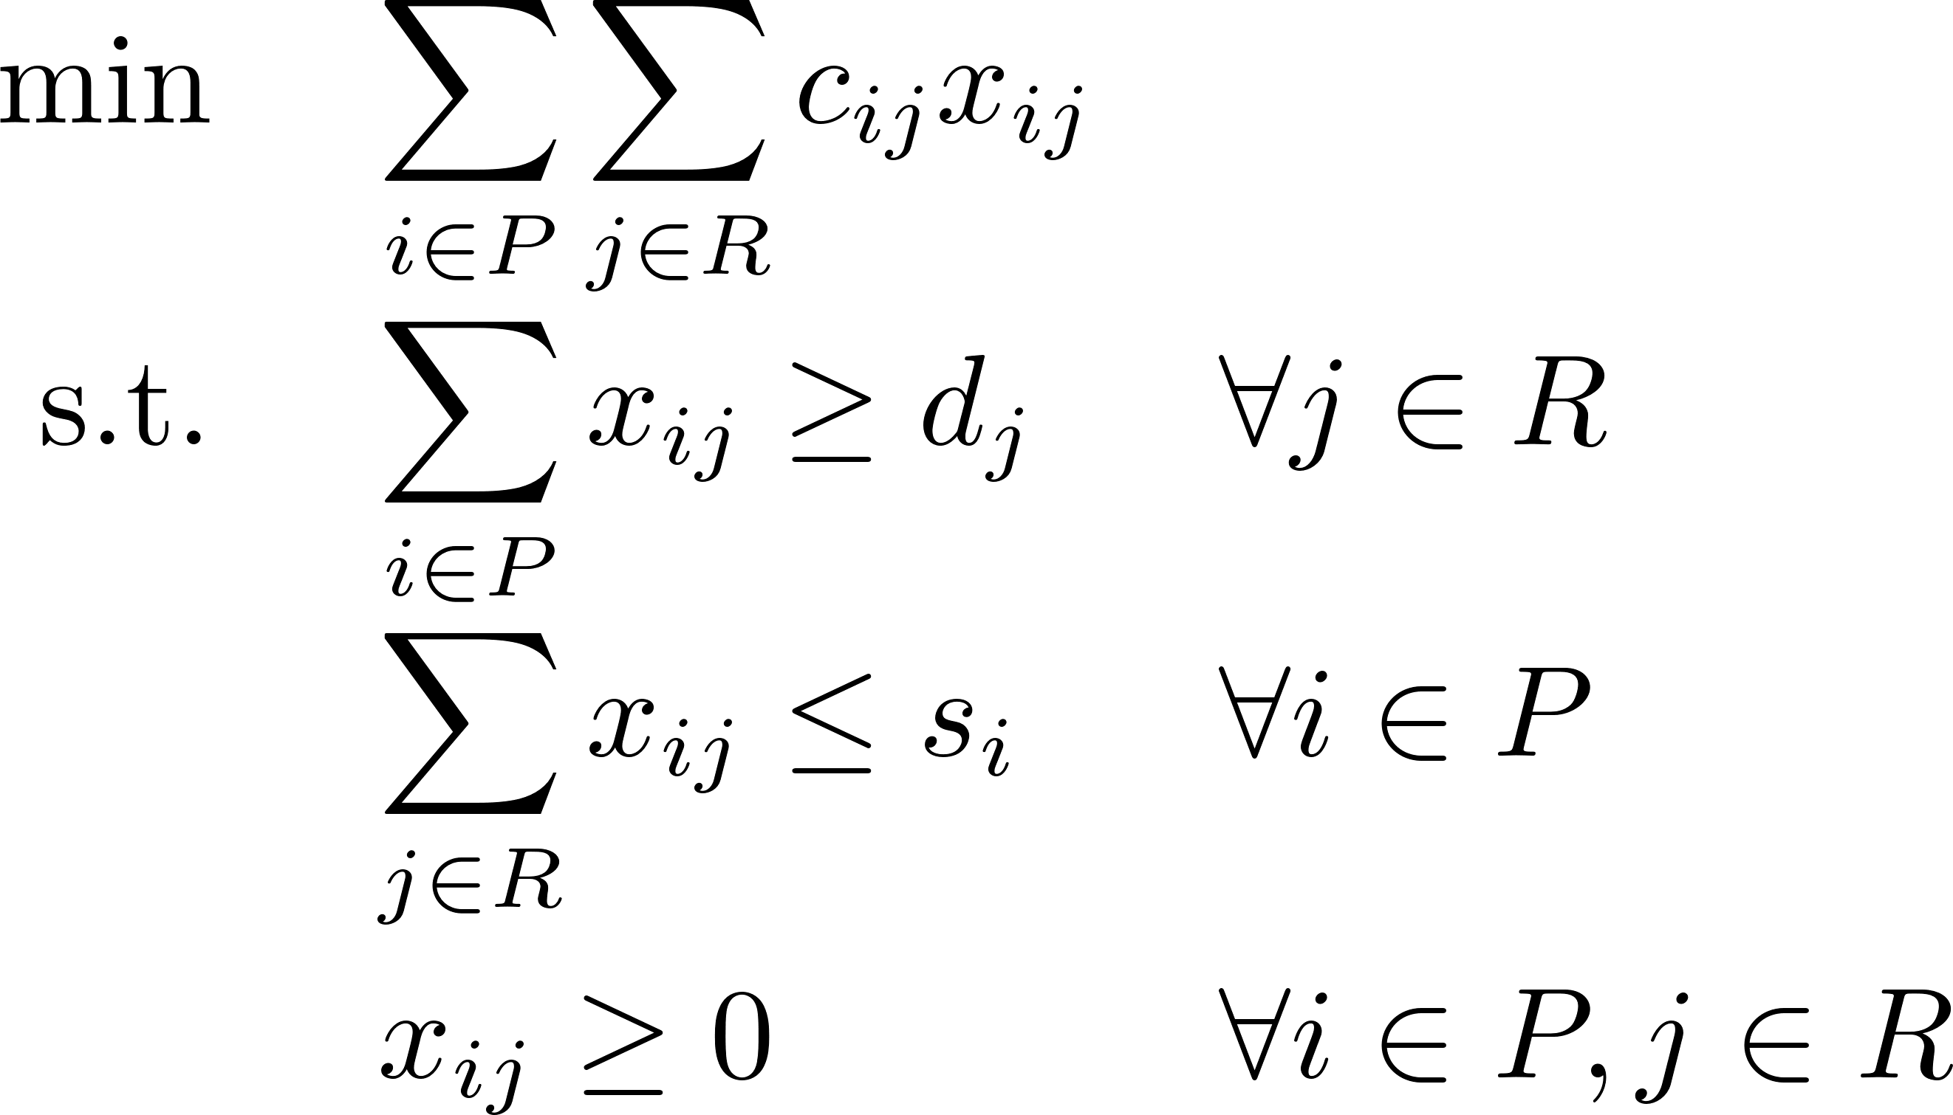
Transportation Problem

Slide 18
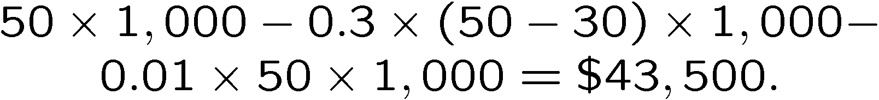
Investment under Taxation
You purchased s_{i} shares of stock i at price p_{i}, i = 1,…,n
Current price of stock i is q_{i}
You expect that the price of stock i one year later will be r_{i}
You pay a capital gain tax at the rate of 30% on any capital gains at the time of sale
You want to raise K amount of cash after taxes
You pay 1% in transaction costs
Example: You sell 1,000 shares at $50 per share; you have bought them at $30; Net Cash is,

Slide 19
Investment under Taxation
Objective: Maximize the expected return next year
Constraints: Able to raise the fund K this year.
Notes:
Pay attention to the time stamps

Slide 20
Investment under Taxation
Notes:
Max{qi – pi,0} is a scaler, i.e., a parameter.

Slide 21
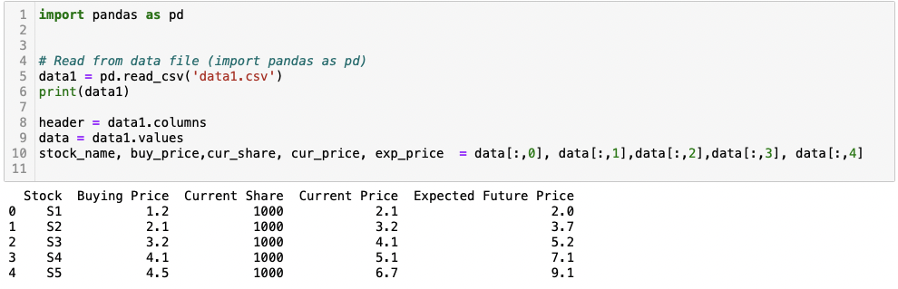
Data File
Read CSV data file
Notes:
If you want to use the matrix form, remember to change the data type to float64:
var.astype(np.float64)
When you assign data to each variable, you can also use dataframe.iloc

Slide 22
Investment on Bonds
Invest amount $K on N bonds over T periods.
Cash earns a fixed return per year
Each bond pays an interest rate that compounds each year, and pays the principal plus compounded interest at the end of a maturity period.
Each bond has a maximum invest limit.
Goal is to maximize the final wealth.

Slide 23
Investment on Bonds
Example: K=$1M, N=4, T=5, Cash interest rate = 2%
Bond | Available Year | Maturity Period | Annual Interest Rate | Limit
1 | 1 | 4 | 3% | 1,000,000
2 | 5 | 1 | 4% | 200,000
3 | 2 | 4 | 6% | 500,000
4 | 2 | 3 | 6% | 200,000

Slide 24
Investment on Bonds
Hint: Cash is available every year and has a maturity period of 1 year and an interest rate of 2%.
 | Year 1 | Year 2 | Year 3 | Year 4 | Year 5
Cash 2% | Y[1] | Y[2] | Y[3] | Y[4] | Y[5]
B1 3% | X[1]
B2 4% |  |  |  |  | X[2]
B3 6% |  | X[3]
B4 6% |  | X[4]
Notes:
Find the pattern,
y[0] + sum( x[i] for i in range(n) if start[i] == 1 ) == K
for t in range(1,T):
y[t] + sum( x[i] for i in range(n) if start[i] == t + 1 ) == 1.02*y[t-1] + sum( x[i]*(1 + interest[i])**duration[i] for i in range(n) if start[i] + duration[i] == t + 1 )

Slide 25
Investment on Bonds

